Slide 1


National Evangelism Strategy
5-year Canada Plan

Slide 2


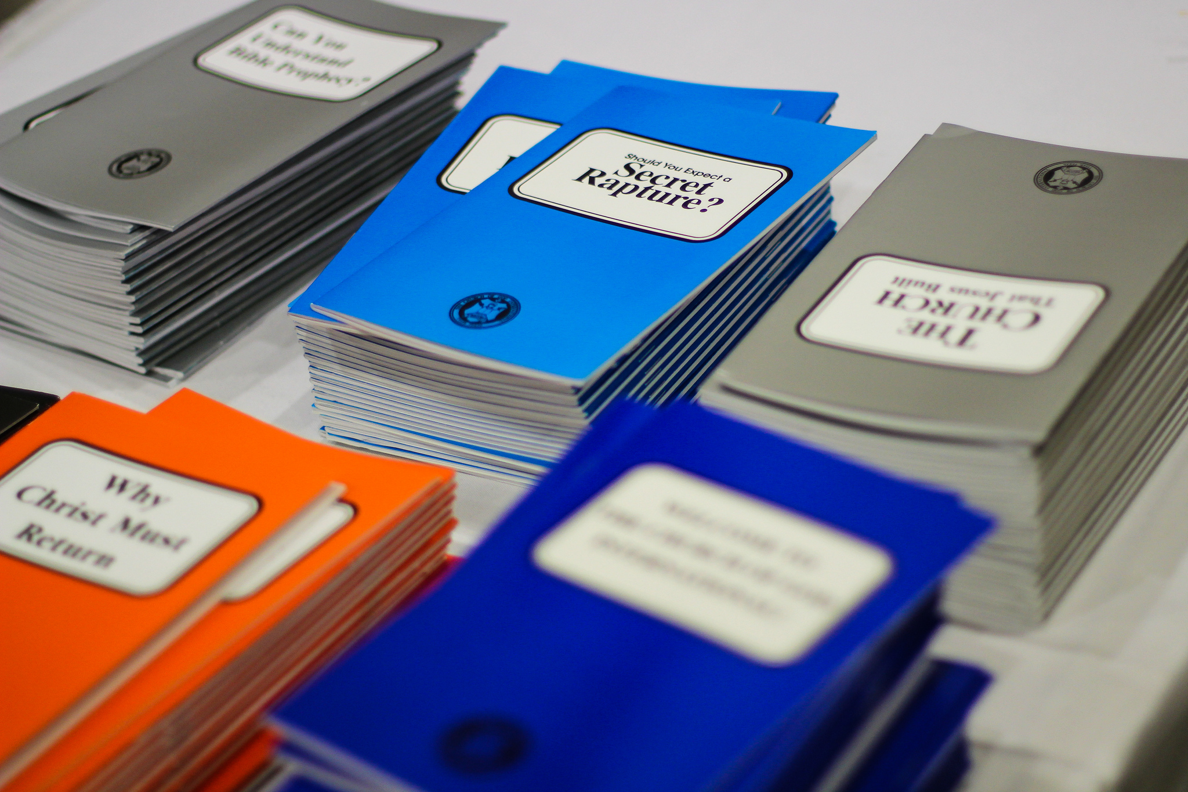
CGI’s Evangelism in Canada 1990-2016
Premise: This document is not about coming up with a mere plan/strategy for evangelism in Canada. It goes back to the very foundation of how it evolved over the years to what is has morphed into now. It has been prepared partially with a historical perspective to give all of us involved in the work of the church, an idea what occurred with its past evangelism efforts, where it stands now, and where it needs to go. It’s important that this background is understood in light of what we see emerging in the life of the church in recent years, especially since the mid-2000s.
It draws reference from the scanty information that’s available from the early years, much of it drawn from experience because of the lack of raw data, but used scrupulously to arrive at some of the conclusions and recommendations on the future of evangelism.

Slide 3

The plan also keeps in mind the 2015 Canada Strategy Roadmap (CSR), which aims to nourish God’s people with the word; to provide health, safe and joyful congregations; to be effective in preaching God’s word; and to become financially viable.

Slide 4
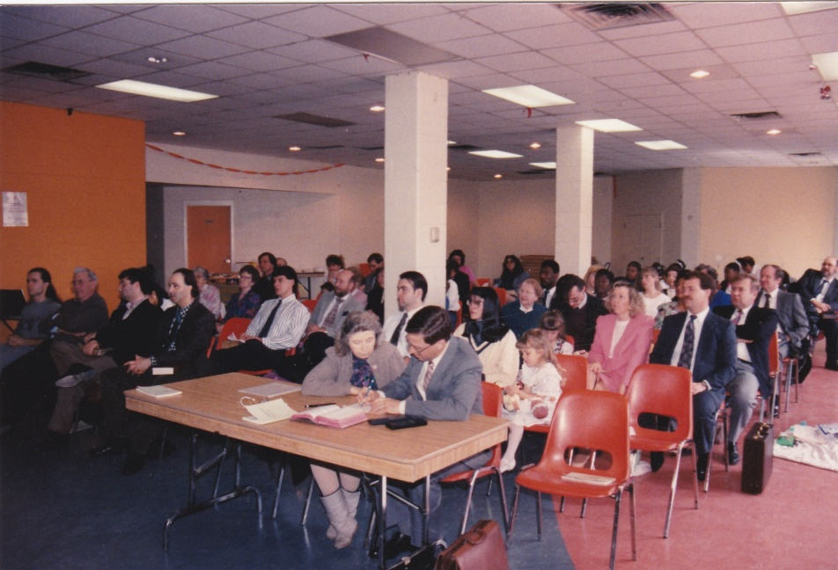
History and Overview
The short history of the Church of God International in Canada is best summed up in simple but meaningful, insightful and inspirational terms that draw from experiences, which are not unique to us, rather they mirror some of the occurrences that transpired in the era of the primitive church i.e. the Church of God has always faced challenges.
The nearly 20 years of history are characterised by lessons we’ve learned; shortcomings wisdom tells us not to repeat, and to grasp the fact that to move forward and prepare for the return of the Christ, we must be cognizant of where we are coming from and where we are going. We are a people of the future. We are futurists. This is where our hopes lie; it is against this setting we must combine our experiences to charter a course equipped with the knowledge and acumen under the guidance of the Holy Spirit to fulfill the commission of preaching the gospel of Jesus Christ and His coming Kingdom.
Church service in Toronto in 1993

Slide 5
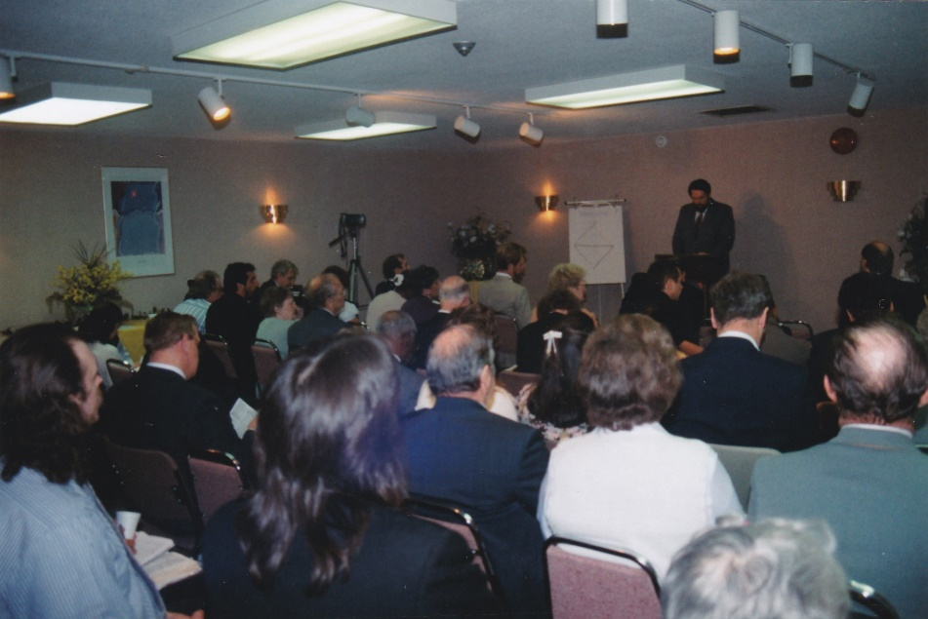
How we measured growth
In the past, as will be borne out in this study, there was an unyielding tendency to measure growth in the church and the success of campaigns by numbers and attendance. We still do this today. Nothing is wrong with it and it’s relevant and meaningful in our quest to do the work of God.
The period 1990-2010 will use this predisposition simply because it was the sole expectation at that time. However, in the preceding years 2010-2016, an entirely different picture regarding growth and attendance unfolds and is still unfolding. The realities of a shifting dynamic in church attendance, campaign turnout and retention, viewing and listening habits, began to change from 2010 onwards. These developments beg the question: does this mean we begin to look differently on how we measure current successes in preaching the gospel?
Toronto church service in 1998

Slide 6
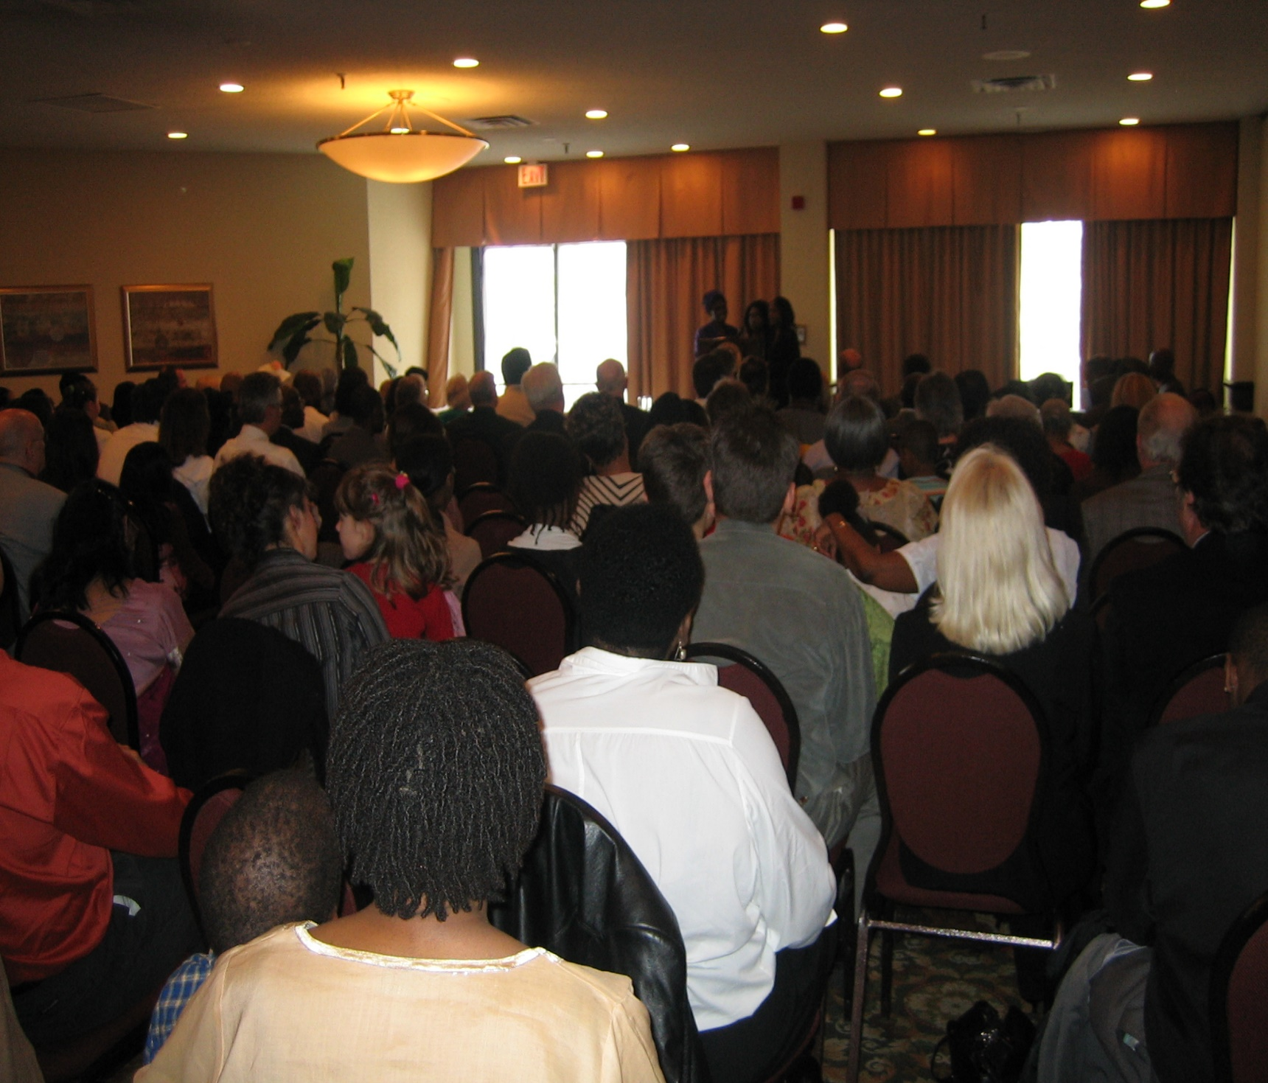
j
The suspect in this case scenario is widespread availability and accessibility of the internet. There are many messages in this for us and this plan/strategy hopes to address them as well to ensure we are not missing out in this information age. Is there a need to adopt a different approach to the expectation of the church when it comes to fulfilling the commission of Matthew 28; 19 -20, as stated in our CSR mission “to preach the gospel to all ethnic groups within Canada as a warning and a witness and to prepare God’s people to reign with Jesus Christ.”
Toronto campaign in early 2000

Slide 7
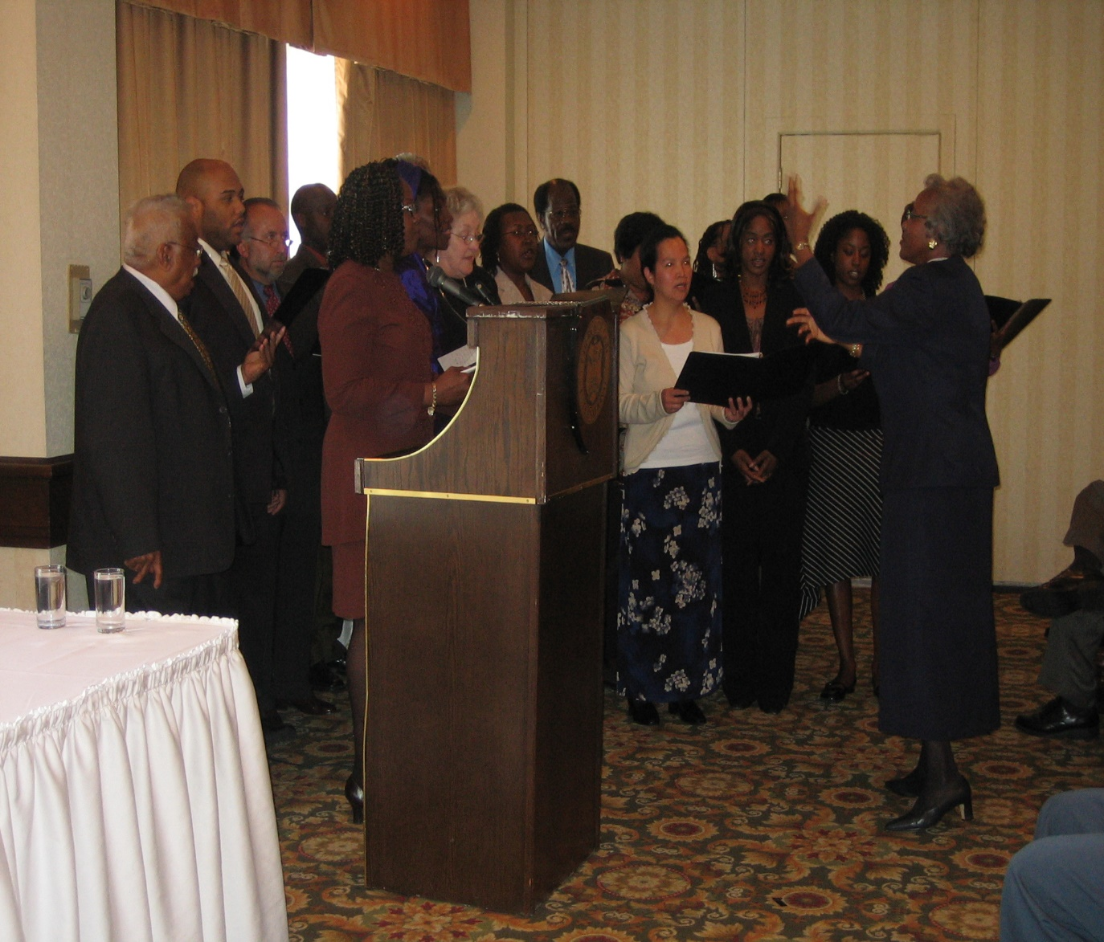
h
So, should it be just numbers alone, as has been the case dating back to the nineties. The records/research emerging will testify to the reality that there has to be changes if we truly want to measure our success against current day trends. Once spending limited financial resources are involved, we will want to measure, but the question remains, how? If we ignore the perceived changes, we could be wasting our small financial resources, inability to obtain goals, and confusion about expectations will diminish our efforts to move forward (as futurists). Furthermore, we have to be cognizant of our CSR vision that by “By 2025, we will have a reputation as an inspiring model for a healthy Church of God organization.”
The choir performing at a campaign

Slide 8
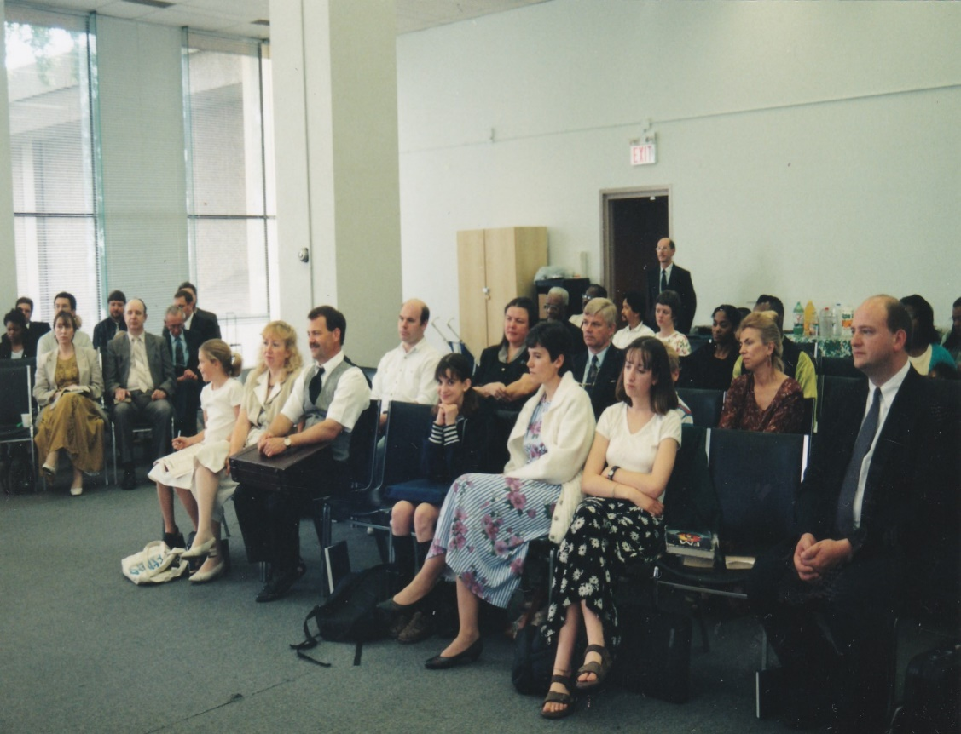
The Genesis of CGI Canada
Church Planting: Let us revisit the past for a few minutes to see what we can learn from the past. Church planting was one of the main emphases of CGI activities in Canada during the decade of the nineties. It was the life of the church back then. The church established congregations in Toronto, Vancouver Island, Penticton, Courtney, Calgary, Winnipeg, Ottawa and Halifax.
The church grew at an unprecedented rate – from a low of 10 in some out-of-province congregations in 1990 to a high of a little over 100 in Toronto within five-years. Toronto had been growing so fast that around 1994, the Canadian board made the decision to set up three congregations as an extension of Toronto – Kitchener, Oshawa and Hamilton. Some members were travelling long distances to church and the venue became overcrowded.
Toronto church service in the late nineties

Slide 9
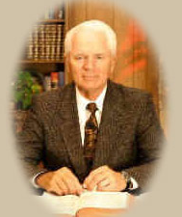
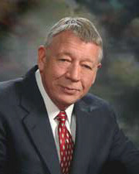
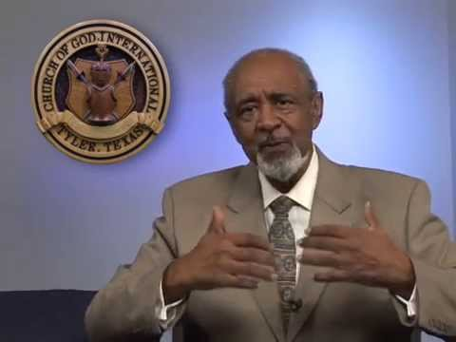
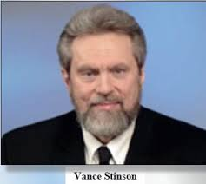
Evangelistic Efforts
CGI benefited from ongoing evangelistic efforts during the decade. From time to time, Garner Ted Armstrong, Ron Dart, Vance Stinson and Bronson James visited cities such as Toronto, Calgary, London, Vancouver, Penticton and Halifax for local campaigns. The local campaigns coupled with the nationally televised Garner Ted Armstrong television programme, and subsequently, The Armor of God, were the driving forces behind an increasing number of visitors. It is noteworthy most of the visitors during that period knew of GTA; the other visitors became disillusioned with what was happening in the latter years of the WCG. Nevertheless, they came, they liked what they saw, and they remained… at least until we had two splits between 1996 and 1998.

Slide 10

The Splits

Slide 11


j
The splits were hard on the church and especially those who chose to remain in CGI. Friends and families parted ways and some gave up on an organized church, and much like others in the WCG, decided to stay at home or fellowship with a home-based group. As the graph below indicates, the splits left CGI with a rollercoaster-like attendance and growth from the mid-nineties to the latter part of the decade.
The first split came at a time of unprecedented growth that was only repeated around 2008-2009. The splits affected every congregation in Canada. People who left thereafter never returned except for a few who showed up in later years. The Canadian Church of God, which hosts a feast site in Collingwood every year since 1996, was the main body formed after the first split when we lost about 50 members.

Slide 12
The Church was growing until…
You will notice from the graph that the pivotal year of growth was 1996 – the same year, the first split came. Two years later, just when the church was in recovery mode from the 1996 split, along came another schism. This time, the impact was even greater, namely because of the establishment of the Intercontinental Church of God by GTA. Those who had struggled to remain after the first split, saw the second one as the final straw. Again, the split went right down the middle and the church lost about half of its membership.

Slide 13
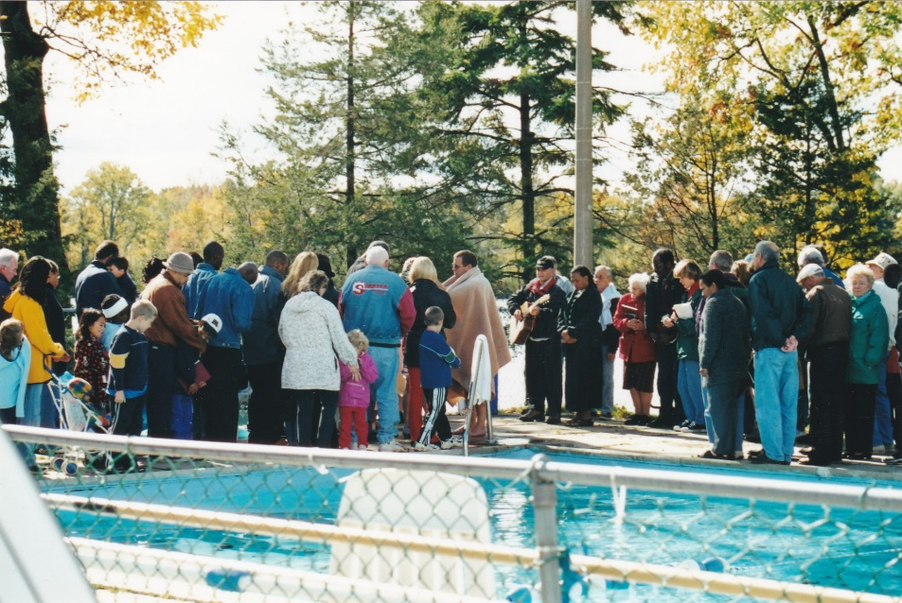
The lingering effects of the second split in 1998 spiralled into early 2000 and left a congregation of unstable, confused, and uncommitted members who became suspicious of the people who had the responsibility to lead them. It was one of the most depressing periods in our history.
However, it provide the opportunity for the church to be re-organized and start anew.
Lingering
Effects
Baptismal ceremony at the Feast of Tabernacles at Elim, Ontario, in 1999

Slide 14


Slide 15
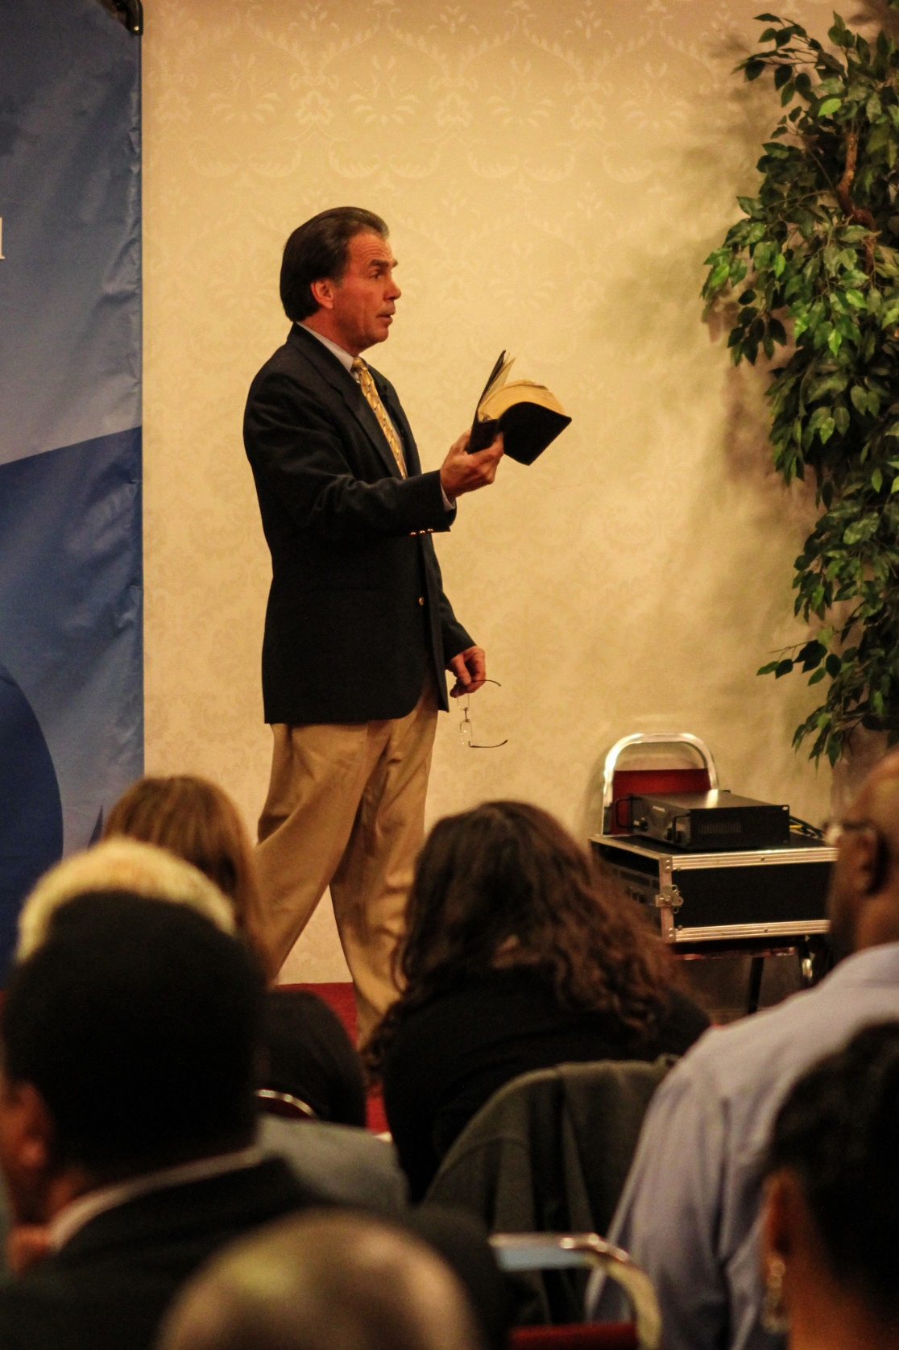
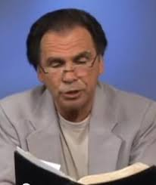
j
Mr. Bill Watson joined Toronto as Pastor of Record following the second split after Mr. Coish sought help from Tyler.
An opportunity came in June 2000 to move from our regular location on Eglington Avenue to a new venue at Bayview Avenue, our current venue. The owners at the Ontario Federation of Labour building on Eglington Avenue leased the room where we met regularly to a new business venture, and gave us the option of another room on an upper floor. The room was much smaller and was not conducive to church services and other related activities. The 25 remaining members at that time saw this as a new opportunity to turn a new page and move on with re-building the church.

Slide 16
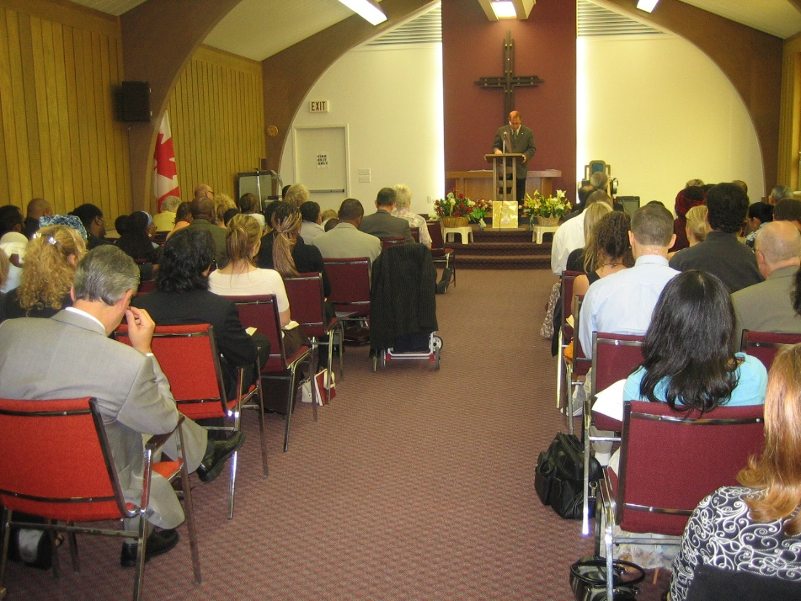
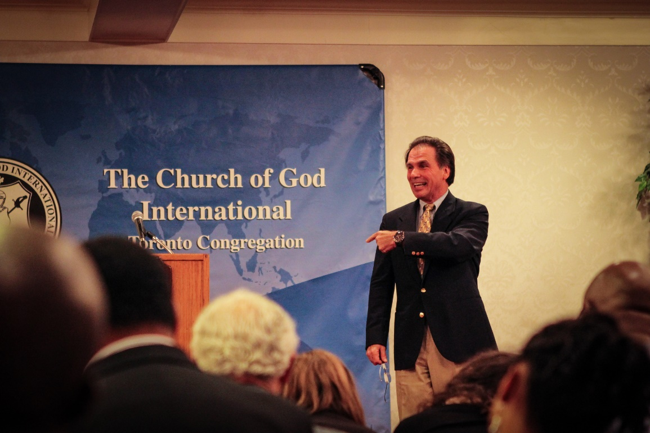
j
An opportunity came in June 2000 to move from our regular location on Eglington Avenue to a new venue at Bayview Avenue, our current venue. The owners at the Ontario Federation of Labour building on Eglington Avenue leased the room where we met regularly to a new business venture, and gave us the option of another room on an upper floor. The room was much smaller and was not conducive to church services and other related activities. The 25 remaining members at that time saw this as a new opportunity to turn a new page and move on with re-building the church.
It was then we moved to our current location with a renewed vigour to step up our evangelism programme and build back our numbers.

Slide 17
Pros and Cons of the Nineties
The church made considerable gains in terms of numerical growth during the decade, but they came at a cost. In the final analysis, the church doubled its membership at the end of the decade, despite increasing it about ten-fold in two separate years before the splits. From this, one can deduce how damaging, counterproductive and unwise divisions are to the body of Christ. Notwithstanding the divisions, CGI held on to congregations in Toronto, Kitchener, Ottawa, London, Penticton, Nanaimo and Calgary. These congregations remained small up to that time and would eventually fold for various reasons.
The task the church faced in the nineties was to build the church numerically and spiritually. We achieved the former, but largely the latter left much to be desired given the realisation that there were two splits in two years. There was no resident elder but our evangelists visited congregations as often as they could. Word of mouth; members inviting friends and families to church became an expectation that proved very valuable to this day. I recall the efforts of Mr. Cosh, Mr. Watson and Mr. Jim French over in eastern Ontario to get and keep things moving to bring stability and a sense of urgency in getting the work back on track.

Slide 18
j
Instability prevailed among members during the last two years of the decade - 1998-2000. Several members couldn’t decide whether to stay or leave; many of those who remained were non-committed and this took a toll of the relatively few of us, who went beyond the call of duty to ensure we had church every Saturday. I can recall one Day of Atonement we had less than 12 people at service in Toronto although we had 25 attending regularly.
The legacy of the nineties remains in some areas of the church to this day. One such legacy is the culture of evangelism, however small, and predominantly so in Toronto, the largest CGI congregation in Canada and North America today. Toronto has had an evangelism campaign every year since 1998, but Toronto is now recording a moderate decline in growth. This is a fact that we cannot ignore, when we devise or implement any evangelism initiative, but times are changing, and that will be covered in the next decade 2000 – 2010.

Slide 19
Some Lessons from the nineties
Evangelism played a significant role in church planting and growth and preaching the gospel.
Word of mouth was a meaningful tool in increasing attendance.
Growth can be one thing, but how to handle it could be quite another. The divisions in Canada occurred when there was a need for strong and committed leadership.
The decade was ripe for spreading the gospel through television, cable television, evangelism campaigns, and word of mouth.
People were more interested in church attendance then compared to now when many are inclined to stay at home and watch a church service. An Angus Reid study in 2015 found that 23-percent of Canadians attended church at least once a month up to the year 2000. Up to last year, the figure was down to 15-percent and indications were the downward trend would continue.

Slide 20
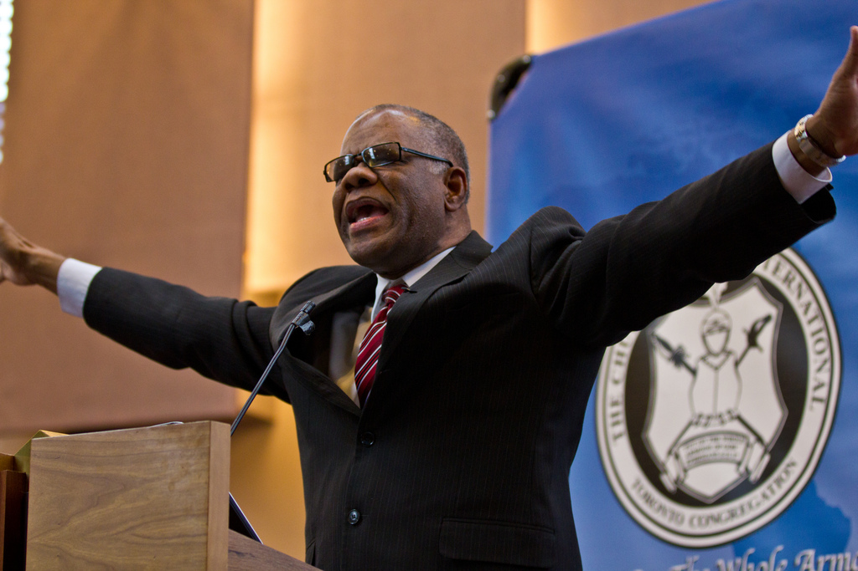
j
Section
11

Slide 21
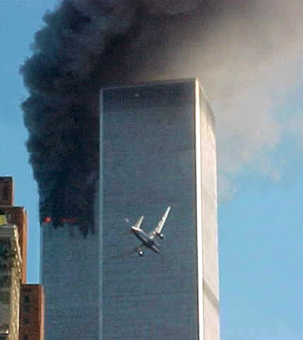
The years 2000 – 2010
The year 2000 continued to feel the effects of the 1998 split. Church hopping remained prevalent towards the end of 2001. I can’t say what, if any, the effects of the 911 attack on the World Trade Centre might have had on people’s psyche, but there were obvious signs of the church in Canada settling down once more following a stepped up evangelism campaign in media and on the ground.
The concept of a 500-channel universe became popular and cable television enjoyed the benefits of this with increased viewership annually. We used this opportunity with emphasis on reaching people through television and personal campaigns. For example, in the year 2000, Vision-TV was consuming 90% of our actual income; from a budget of around $150,000. Nevertheless, we received quite a number of enquiries from people who watched the programme and wanted to attend service. I remember getting 5 - 10 calls a week.
?

Slide 22
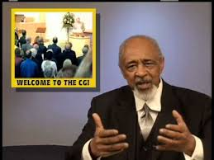

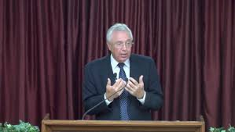
r
At the same time, the church launched evangelism campaigns in Ontario, Alberta and British Columbia, which involved the new presenters on the Armor of God, namely Messrs. Watson, Stinston, Groce, James. About mid-2000, Toronto had 13 baptisms in one year, a feat not achieved in any other CGI congregation in Canada to this day. This was indicative of the trend at the time – from 25 members in 2000 to 50 – 60 by 2005, despite the memorable and haunting images of the division that occurred earlier.
Through the hard work and efforts of Mr. Coish and Mr. French, with the help of Tyler and Mr. Watson, the church explored other medium and better and more affordable time slots for the Armor of God television programme.
At the same time, the church launched evangelism campaigns in Ontario, Alberta and British Columbia, which involved the new presenters on the Armor of God, namely Messrs. Watson, Stinston, Groce, James. About mid-2000, Toronto had 13 baptisms in one year, a feat not achieved in any other CGI congregation in Canada to this day. This was indicative of the trend at the time – from 25 members in 2000 to 50 – 60 by 2005, despite the memorable and haunting images of the division that occurred earlier.
Through the hard work and efforts of Mr. Coish and Mr. French, with the help of Tyler and Mr. Watson, the church explored other medium and better and more affordable time slots for the Armor of God television programme.

Slide 23
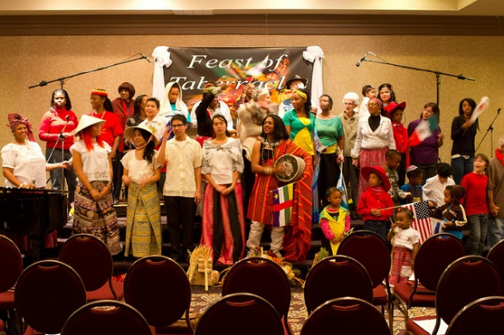
Feast Attendance
Worthy of note, feast attendance between 2000 and 2005 remained steady for the most part as indicated in the graph below, except in 2000 and 2001, a couple years after the split when instability lingered. However, we saw an upward trend in 2003 perhaps because of the location – Niagara Falls, which usually attract Americans. From 2005 onwards, we started to see an upward trend once more and this continued into 2010.

Slide 24
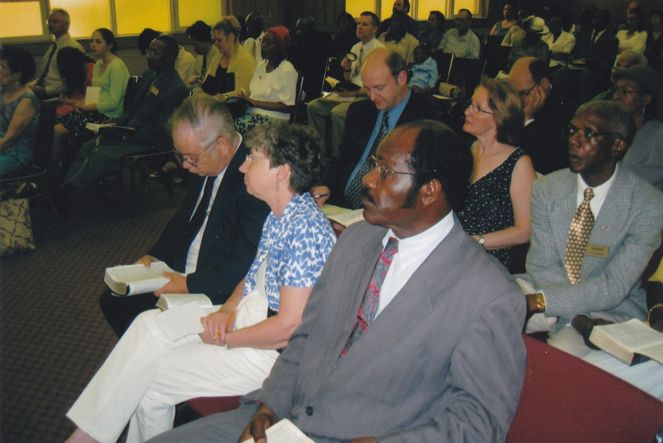
Campaigns from 2000-2010
There were campaigns in most congregations, but Toronto was consistent in having at least one every year. It was during this period Toronto recorded its highest number of baptisms in one year (13). I recalled the Kitchener, Ottawa and London congregations remaining stagnant for a while; out west, there was minimal growth. Inconsistency in having outreaches could have been a factor in the slow growth period.
It is notable there was no traditional media advertising for these campaigns. Character-generated ads on the Armor of God, invitational letters from Tyler, word of mouth and notices on our website were the channels used. Those were the publicity tools of the day and we made good on them.

Slide 25
j
Again, drawing reference to Toronto, the largest congregation, it has been able to have baptisms every year since 2001 to present. The figure could vary anywhere from 1 – 8, except 2005 when we had 13. The majority of these baptisms were from campaigns. By the end of 2010, the estimated average attendance in Toronto was 90; Kitchener 40; Ottawa 15; London 12; Vancouver Island 20, Winnipeg 20; Calgary 25 and Penticton 15.
However, data showed the church received a high of 6,800 pieces of mail in 2000 more than any other year in its history. We can glean from this milestone that people were showing interest again. More details in Section 111).
There was growth considering the steep climb to stability following the events of 1996-1998. In fact, some congregations came pretty close to equalling the figures for the nineties.

Slide 26
Lessons from the period 2000- 2010
Instability is harmful to church growth
Leadership is central in keeping the church unified and stable
Consistency in having campaigns/outreaches is a key ingredient to sustain meaningful growth
Word of mouth, invitation letters, remain effective methods of advertising
Airing programmes on cable television, although popular, was costly; they reached people, but the cost might have outweighed its effectiveness.
Incoming mail started to decline in 2009 and this continued into the next decade (More detail on this in Section 111). Was this a sign of change?

Slide 27
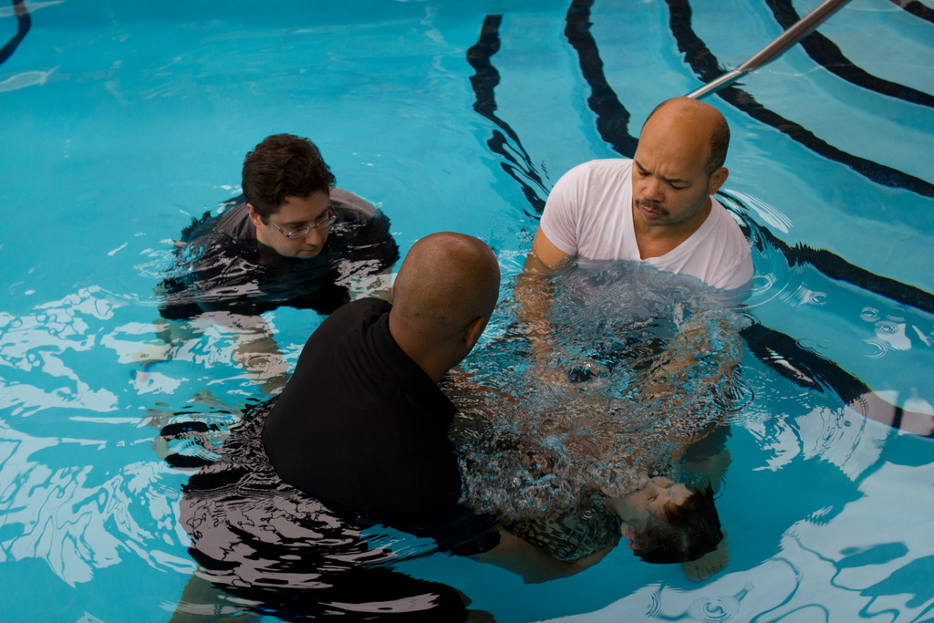
Section
111
g

Slide 28
The period 2010- 2016
We come to the current period 2010 – 2016. I believe this period in our history comes with mixed blessings. The “mixed blessings” can be attributed to the following:
Our finances almost doubled from the 2000 – 2010 period
Attendance was also up in some congregations; in other congregations it remained steady. In the case of Toronto, we see started to see a moderate decline. We lost some members to the formation of the Burlington congregation in 2013, which resulted in a sharp dip, but there was a slight recovery in the early part of 2014, only to begin another steep decline.
We lost members in Calgary and Nanaimo in 2015. The loss has contributed to an overall moderate decline in attendance and membership for the six years under review.

Slide 29
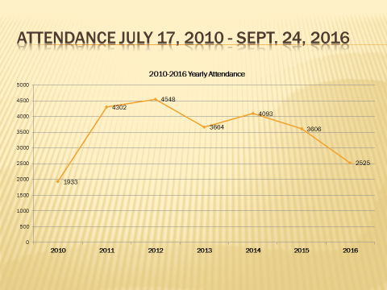
Attendance 2010- 2016
We use Toronto as our base simply because of its growth pattern over the years and it’s the biggest congregation in Canada. The statistics come rom Fellowship One, which has been storing data since 2010.

Slide 30
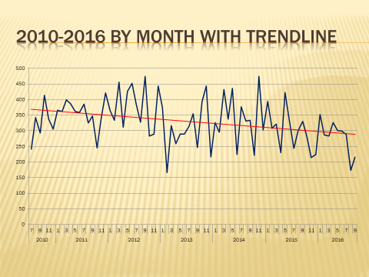
What the graph is telling us
Here we can observe that there was a steep rise in attendance beginning in 2010. It reached a peak in 2012 with over 100 in attendance, then Burlington was formed in 2014. As expected, there was a decline in numbers. However, attendance started to increase again in the latter part of 2014, but declined in the next two years. However, since last summer, we have started to see a slight upward trend.

Slide 31

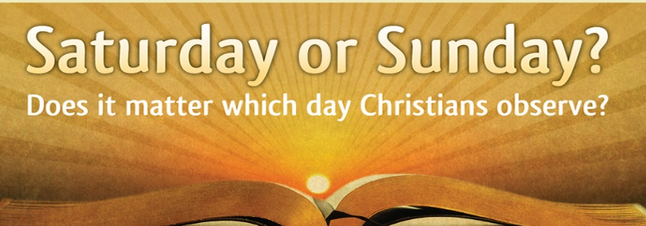


Major campaigns 2010- 2016
2013 Prophecy Conference; attendance * (9)
Four Days That Will Change Your Life; (30)
Are They Lost? (160)
Why Were You Born; (8)
What Happens After Death? (10)
Saturday vs Sunday (debate) (35)
Blood Moons; Sign of the Times? (50)
Has the fig tree of Matt. 24 begun to put forth its twigs?
Does God’s Grace Nullify the Law; (16)
Is Allah the God of the Bible? (145)
*Attendance.

Slide 32

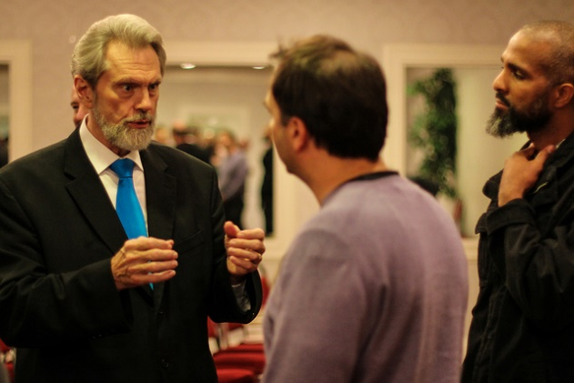
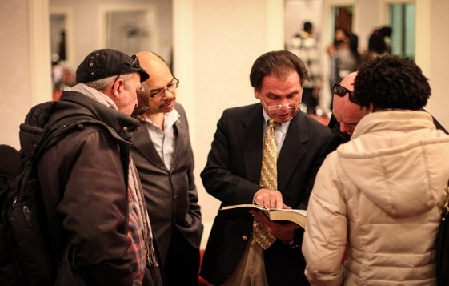
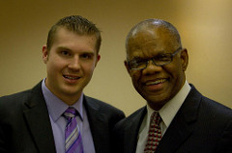
h
From these subjects, we can see attendance varies. However, the interesting fact is none of these campaigns has increased our numbers substantially, if at all. There was one regular attendee from the 2013 prophecy conference, who has since stopped coming, although we had follow-up visitors for a few weeks after the conference. There was one person attending Kitchener for a while from the Blood Moon campaign, who has since relocated to Alberta. Of note also, is the Are They Lost campaign, which attracted 160-people but there is no one as yet who has been attending any of the congregations regularly.
Earlier, I mentioned there was a pattern in the nineties and early 2000, whereby you would see occasionally one or two people from a past campaign showing up for services months after the event. That pattern seems to have disappeared.

Slide 33
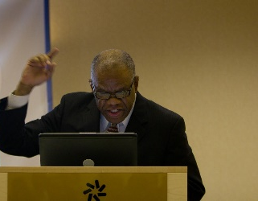
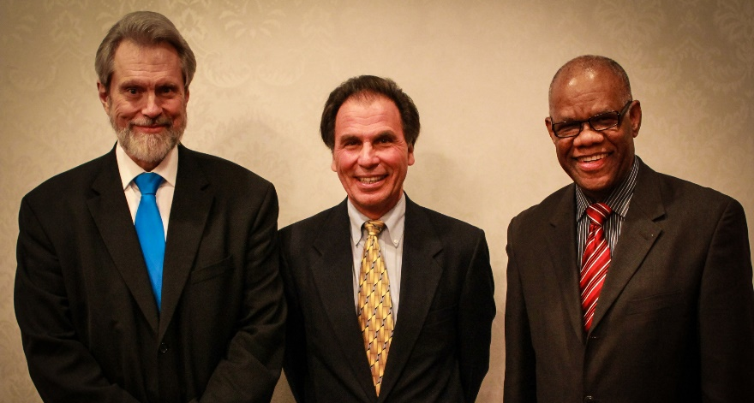
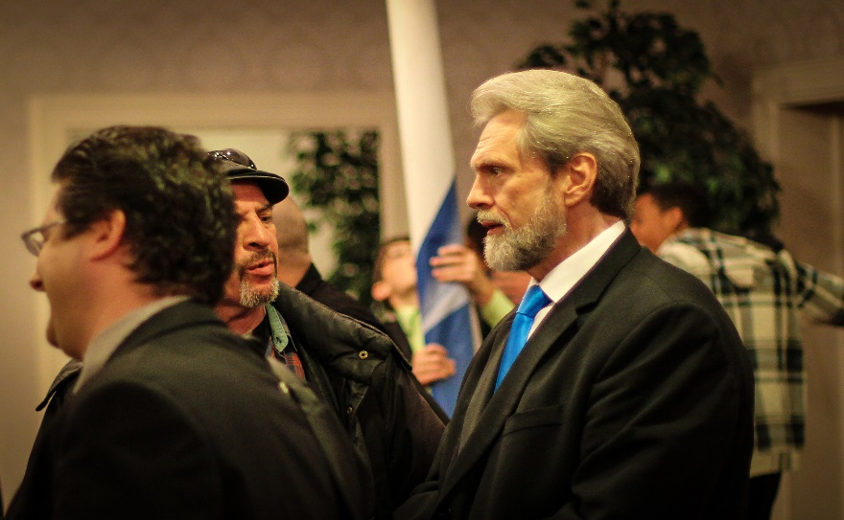
j
This implores us to ask the question: is it fair to limit our success at preaching the gospel to just numerical growth? Do we measure our success using other factors to determine the depth of our reach? For example, the Saturday-Sunday debate a few years ago had more than 25,000 hits on the YouTube video before the other participant in the debate pulled down the site, after recanting his stance on Sunday being the sacred day of worship. It was off YouTube for a while and another person posted it in August 2016.
So far, it has nearly 1000 hits and has started another round of debate by online visitors. Is that success? I’m sure it is success in preaching the word.
How about the 800-people who watched the live streaming of Is Allah the God of the Bible? For sure, the hits will come in the years ahead because it’s a topical and heavily debated subject.

Slide 34
New factors driving Church attendance and growth
Page Views 2016 | New Visitors | Return Visitors
7,303 | 66.3% | 33.7%
I have been personally monitoring attendance in Toronto over the past three-years after it became obvious that the vast majority of our visitors are coming after simply “googling Sabbath-keeping church,” and CGI happens to be on the front page. The figure above gives an indication of the number of people visiting the site. In the past two years, two out of every visitor, who have attended, came through that medium. Some continue to visit from time to time, others have not returned, which is another aspect of church growth that needs a separate study.
Word of mouth, and now social media, have proven the most influential method in bringing people to church. Often times, these people are family members or friends and there’s a bond that already exists. We see similar trends in other congregations outside Toronto. To quote an elder at one of our congregations in Ontario “I would suggest that our visitors are a combination of a 50-50 split between word of mouth and internet, with little to no impact of the campaigns.”
Another elder: “I think only one came as a result of one of the campaigns. 3 have attended (occasionally) because of former associations with WCG, one family of 3 through the internet (who have also brought other family members) and a friend of that family via word of mouth. One other person my sister-in-law as a result of inviting her to attend so I guess that would be word of mouth as well…. 20% campaign; 40% internet; 40% word of mouth.”

Slide 35
From the statistics gleaned from the Muslim Debate, social media ads and word of mouth were the two most effective methods of getting people to attend. Flyers and emailing were much less effective. Invitational letters were absent.
Two years ago, we discontinued the nationally televised programme The Armor of God for a number of reasons. Carried by Vision-TV, the programme ate into most of our budget, but based on cost and response, it had become too expensive to maintain, especially when there were other ways of getting the message out. At the same time, CGI President Jim French says “Comments (board members and public responses) from 2013 justify staying with Vision ...”
Yes, the Armor of God helped people, especially those who were unable to attend a service because there was no church in their areas, but it goes back to the question of the heavy cost.
On the other side of the coin, what impact did the discontinuation of the programme had on our income? Again, Mr. French “The year-end financials show a significant drop in Income between End 2014 and End 2015 (Vision finished End Feb 2015) But ... The drop in Income also reflects Western Canada leaving.”

Slide 36


h
I’m sure there was some kind of impact. That’s undeniable, but does the decision to leave cable television measure up to Tyler’s own decision to come off television altogether and use social media? There has to be some parallel here.
Statistics from Social Media 2016
Let’s look at these statistics from Tyler for the past year following their decision to go off cable and use social media instead.
Views–Dec 7th, 2015 to Dec. 7th, 2016
I got this dispatch on Tyler’s Facebook figures:
“Facebook post reach for November 2016––937,752. (This is about average.) At this average, our "post reach" is approximately 11 million / year[Post reach is our "potential exposure" from our network of Facebook connections /followers]. We presently have about 23,000 followers on Facebook … This is the highest among the Churches of God… The closest 2nd is about 13,000…”
Weekly | Monthly | Annually
5,919 | 25,652 | 307,826

Slide 37
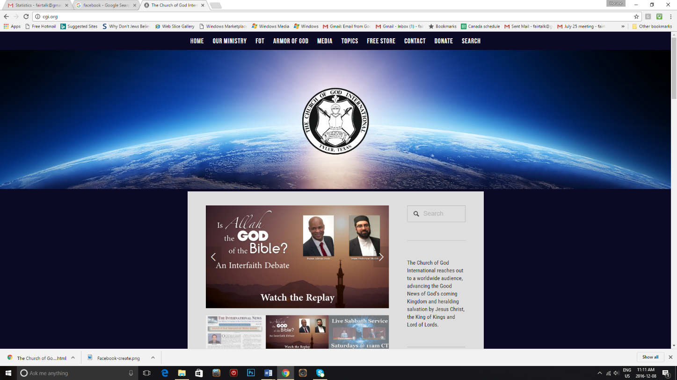
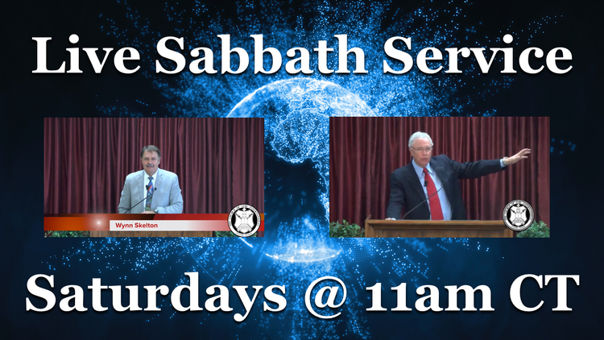
Our headquarters’ website www.CGI.org
Again Tyler’s reports on the 2016 visits to the website: www.cgi.org. Note: The figure compares to 300,000 for the year 2012, the start year for the new site.
Weekly | Monthly | Annually
17,007 | 73,700 | 884,000
Live Sabbath Service views
“Weekly Sabbath webcast now reaches over 1000 connections (average 2 to 3 per connection) each week and is simulcast on CGI.org; Facebook; Youtube; and Roku.”

Slide 38
j
Let’s face it, these figures are unmatchable to the days of cable television when it comes to reaching people. While responses are up though, the same cannot be said for income from social media. One would hope that with time we will begin to see a big improvement in this area.
Tyler’s response: “we are still lower than when we were on T.V. However, this is in the day-to-day income category. If you take it over-all, including the estate settlements and the occasional extraordinary offerings that come out of the blue; we are in the best financial position we’ve been in since 2000… But, day-to-day we are not keeping up with our overhead…
Most of the ‘extracurricular revenue’ comes from non-church members… Responses/ requests for materials are up, which obviously adds to our costs… Keep in mind donations are growing, but slowly.”
We can hope this slow growth in income will improve gradually in the near future. I attempted to get the Canadian responses regarding feedback from Tyler’s programmes on social media, but Jeff is a busy man and I couldn’t get them in time for the presentation of this report. We now turn to other aspects of the Canadian situation.

Slide 39
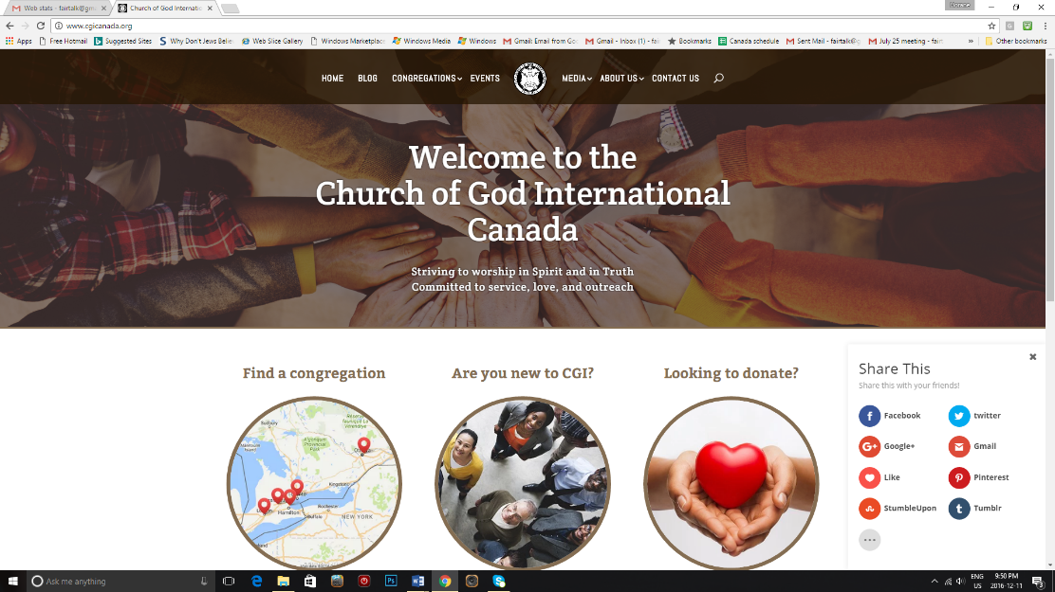
CGICanada.org
The old CGI Canada website had daily visits ranging from 10 – 450 daily – or over 5,000 a year. The new site, it is hoped, will experience a gradual increase in the years ahead.
Letters/ Literature Request in Canada
In the early years, our television presence meant there would always be request for literature or people making donations. The figures below indicated a steady decline in mail long before we cancelled Vision in 2015. We see the decline started in 2009, and with Vision’s cancellation, there was no big dip in mail, it was just the trend continuing from 2013.

Slide 40

J
CGI Mail Received
2013: 4684 pcs (steep decline began)
2014: 3530 pcs
2015: 3282 pcs
2016: 2104 pcs (to Nov 30) Dec will be around 150-200pcs.
*Not all mail is accompanied by a literature request.
Our head office in London added this: “In early 2000’s we received yearly over 6800 pcs. In 2009, we began a decline to 5550-5000 pcs/yr. until 2013 when we began to drop off completely to the present amount.”
As we conclude 2016, we need to glance back at the revenue trend from 2000. Here’s what I found from the figures:

Slide 41
Canadian Revenue trends
2000: REVENUE $153,055 EXPENSES $152,677 (of which Canadian Work/TV=$121,615)
2010: REVENUE $291,385 EXPENSES $310,602 (of which Canadian Work/TV=$110,589)
2016 (Up to Nov.) REVENUE $259,000 (estimated)
Note the 2000 figures show more than that of 2010 regarding work/tv expenses. We took in more revenue but we went over budget and the decline in responses continued unabated. At the same time, the revenue went up significantly within ten-years – 2000 - 2010. However, the 2016 figure will end up showing less revenue than in 2010, which is indicative of fewer people paying tithes, offerings and donations.
Our CSR goal was to take in revenue of $425,000 in 2016. The figure for 2017 is $500,00 as stated in our CSR. We didn’t make the 2016 figure, ending up at around $259,000; some of us may want to argue that the 2017 figure is unrealistic, but the challenge is to keep on building on what we have, keeping our goals and vision in mind, and at some point in the future, we can reach that figure with God’s help.

Slide 42
Observations from 2010 - 2016
Observations from 2010 - 2016
What can we deduce from preaching the gospel as it affects our campaigns/church attendance over the past six years?
There has been a shift in the pattern of attendance at campaigns and church i.e. people are not turning out in the numbers of the nineties and early 2000. Social media have taken on a significant role in reaching people during and after an event.
The internet now contributes significantly to visitor church attendance.
People continue to come through word of mouth.
We need to return to the use of invitational letters, which have proven very effective in our past turnouts.
Hotel venues are not necessarily better for regular outreach events. They are costly and have not been proven more effective (more in the strategies).
The success of our campaigns should not only be measured numerically as social media have provided new means of reaching people without seeing their faces or getting responses.
We are getting less revenue than in 2010.
We are also spending less.
The question for us: where do we go from here as a church to preach the commission given in Matt. 28?

Slide 43

G
Section 1V The Future of Evangelism in Canada

Slide 44
jii
It’s not matter of whether evangelism has a future in CGI Canada. An organization without an active evangelism programme is going to die, and some have, and will, continue to experience that fate. For the CSR to be of any value, evangelism has to be one of the dominant pursuits in our quest to survive as an organization.
Christ’s very own admonition shortly before his ascension in Acts 1 is for us to be witnesses to all nations. One of the ministries given to the church in Ephesians 4:11 is that of an evangelist. There’s no way we can dismiss this subject, fold our arms and say let’s just wait for the return of Jesus Christ. We have a responsibility to honour his word and command.
It’s true, the Church of God movement does not have an active culture of evangelism although CGI has been at the forefront of developing one, albeit small in scope. However, with an aging church, we see clearly now the need for us to grow or die as an organization.
We have used procedures in the past that have worked, but needs modification. Equally so, we have used methods that are no longer effective in our information age and have to be abandoned partially or totally, if we are serious about evangelism.

Slide 45
u
Let’s face it! Social media have changed people’s listening, viewing, and reading habits. “Social media have changed our world,” says one popular commentator recently. Even the powerful medium of cable television is declining rapidly, most industry watchers agree. While traditional radio is holding its own, internet radio and livestreaming are getting increasingly popular.
We also have to contend with the haunting prospect of a post-Christian era, where religion is becoming less relevant to people in many parts of the world, especially Western Civilization. The signals we’ve been getting over the past six years are not only unique to CGI, but the Christian world in general is confronted with the same challenges. We know the Church of God will prevail, the Head and Founder of the church tells us, nevertheless, we have a responsibility on our shoulders to fulfill our commission.
Strategies for the next 5-years
Goals
The goal of this strategy is to reach as many people as possible with the gospel; to restore growth, and at the same time, maintain levels more consistently, unlike the rippling levels we have seen since the mid-2000s.

Slide 46
j
While a return to the levels of the nineties cannot be ruled out, we need to concentrate a great deal in keeping the members we have now, and those that will come in the ensuing years.
Mission
The mission of evangelism must be in keeping with the 2015 CSR to nourish God’s people with the word; to provide health, safe and joyful congregations; to be effective in preaching God’s word; and to become financially viable.
I have put together a 5-year plan/strategy I believe is a starting point to address our evangelism concerns, and most importantly, to ensure we don’t deviate from our calling and expectations as a church and in keeping with our 2015 CSR. The plan is not written in stone, but should be seen as a guideline that will ensure we achieve goals that we set out to attain in fulfilling our mission and vision. Given the changing times we live in, there’s room for adjustments to address any development or concern that may surface in the current geo-political and religious climate, as it affects the life of the church and its commission.

Slide 47
h
From the figures we have seen, social media and word-of-mouth are the two most influential ways of reaching people nowadays, a stark contrast to the days when we depended on campaigns and cable television. Therefore, this strategy will place emphasis on social media, word-of-mouth, personal evangelism and not to be left out - campaigns.
The first year of the strategy incorporates some aspects of the previous 3-year plan put forward by Pastor George Ramocan, which would have ended in 2017. As expected, some areas of his plan are in progress and will continue to be operational for now.
Pastor Ramocan has already outlined in his plan THE BIBLICAL TEMPLATE FOR GROWING GOD’S CHURCH. A copy is attached to this plan; it remains relevant and will be used accordingly.
I have looked at our evangelism activities in the past two-and-a-half decades and is convinced that we need to make some adjustments to keep abreast of a society that is undergoing rapid transformation in all aspects of life. The CSR seeks to address some of these concerns and this plan complements the evangelistic aspect of that vision. The strategy:

Slide 48

Financial Strategy
As the CSR points out, CGI brings in the lowest revenue of all the Church of God organizations in Canada - for example, the LCG on top with $2.7-million in 2013 compared to CGI’s $345,000. To change the picture we need to educate our members about tithing (more on that later), to take ownership that they belong to the church, and to buy into our vision. It also means we must look closer at how we use scarce financial resources.
One of the areas I’m proposing we look at is our venues for campaigns, which is costly in most cases. We need to keep hotel venues and all their accompany expenses to a minimum. Hotel costs eat into about a third of our evangelism budget and it has not proven any more advantageous than regular church venues. We have been using hotel venues for as long as I can remember and they have not proven to draw or retain more people after an event.
There are exceptions when an event warrants a hotel atmosphere, but for the most part, we will use suitable and more affordable venues other than hotels, unless we find hotels that are more than reasonable and won’t put a dent in our budget.
During the past decades, we’ve hold the concept that it’s better to have our campaigns at neutral venues such as a hotel or another location apart from our meeting places. We concluded rightly or wrongly that people might feel intimidated by a church building or a church atmosphere. I believe the time has come to dismiss that idea, except in circumstances such as the Muslim debate, where a neutral venue is advisable for more than one reasons.

Slide 49
k
However, for a regular campaign, the evidence is not there that it’s better to use a hotel venue. We should begin to accept that when God calls, a church building or a hotel does not matter to a person seriously. While hotels are costly, they have not resulted in a greater turnover of visitors. In fact, some of our past campaigns at our Toronto venue have turned out more people than hotels.
The provision of foods contributes much to the hotel bill. If an event at a hotel, excludes food, the cost will be much lower. I was surprised that a recent CGI campaign in Atlanta did not have food, and the host church informed attendees about the restaurants in the area. Can we use a hotel without having to provide food and simply ask people to buy their own? If we are going to use a hotel, then that’s the route to go. The reality is the church can no longer afford to provide food when we use a hotel. Many churches don’t do this, why should we?
The food bill for our August event was $1,700. We asked for a contribution from members and visitors and it amounted to about $900. We’ve had campaigns in Toronto at our regular meeting place where we used about $100 from our Love Fund to buy tuna, salmon, and roast beef for sandwiches; we also asked members to take extra food and it worked beautifully. Our future campaigns in Toronto will utilize the latter way to provide food refreshments.

Slide 50
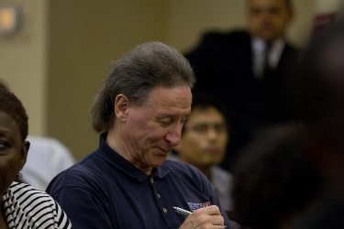
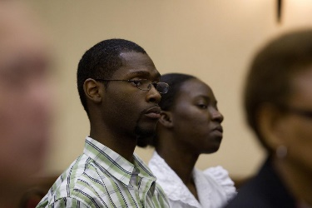
j
From now on, we will begin to hold our campaigns where we meet for services. There will be instances when a hotel may be required, but for the most part, they will be held where we meet. The money we spend at hotels will be channelled elsewhere in evangelism, for example, the next subject (Social Media).
A part of our financial strategy must be to preach tithing more often than we do. I will do PowerPoint presentations to all the congregations throughout the year on “Tithing: An Act of Worship.” Hopefully, this will bring more awareness among our members that indeed tithing is an important part of worship. Elders are also being encouraged not to forget this subject in their respective presentations.
I would also suggest, as part of the strategy, that a donation option is placed on each congregation’s website in the manner of the national website.
Campaigns

Slide 51
g
SOCIAL MEDIA: Spot-Ads
The money saved from hotel bills will be used for spot-ads on Facebook and other social media weekly or bi-monthly/monthly advertising the meeting places of all our congregations and at the same time posing a tease on a doctrinal question.
Spot-ads need to be sustained to be effective. The impact of running an ad for a month or two is not felt as much as one that has an extended life.
SOCIAL MEDIA: Website
If we need to scrutinize any area of our outreach programme, it is to our website. Many thanks to Jim French, Shey Smith and the rest of the team for having the new site up and running. The task is now to keep it updated regularly with new and emerging features. There’s a time-frame outlined in the yearly calendar for the implementation of all the features/contents to have the site fully functional. Mr. French will give an update later.
SOCIAL MEDIA: Internet Radio
This was one of the proposals in Pastor Ramocan’s evangelism plan. Toronto member Louis Anane approached me last October about the idea of using internet radio in our outreach without even been aware of Pastor Ramocan’s proposal. Mr Anana will give us a report later.

Slide 52
J
I asked him to do some research to determine the feasibility of having internet radio. From his report, it’s feasible, and so it has now become a part of our plan in evangelism.
SOCIAL MEDIA: livestreaming
Livestreaming of church services will become a regular feature of our weekly activities. The aim is to have live streaming from each congregation on a alternative basis by the end of the 5-year period and aired on our internet radio. The Thursday night bible study will also be added. Other programmes will be explored as well.
SOCIAL MEDIA: Short doctrinal features on YouTube/GodTube/internet radio
5-minute commentaries on a doctrinal or topical subject will be produced and aired via these media. The hope is to eventually expand to 15-minutes.
SOCIAL MEDIA: Prevail Magazine online
Prevail magazine will now be produced as an online magazine (not printed anymore) beginning in 2017.

Slide 53
h
SOCIAL MEDIA: Youth Play
Our young people are rehearsing a play for YouTube (Pastor Ramocan’s initiative). It features a biblical narrative. We intend to complete the first one in 2017.
    Word of Mouth - Personal Evangelism
Word of mouth is a major component of the strategy. We have a manual on personal evangelism developed two years ago incorporating the one produced in Tyler, that is just gathering dust. It is now available for download on the new CGI Canada website. Every member of CGI in Canada will be encouraged to download a copy and to start reading it. If we are to strengthen word-of-mouth/personal evangelism, which we hope to do, this is where to start.
This effort will be complemented by a series of seminars on how to personally evangelize to be held in Toronto, Kitchener, Ottawa, London and Burlington between January and April 2016. The progress in personal evangelism will be reviewed the following year during a series of follow-up workshops. This is critical to ensure members keep this practice going.

Slide 54
J
Word of Mouth – Business cards
Each members will asked to carry a business card advertising their respective congregation’s contact information that they can easily give to a friend, relative or co-worker.
Word of Mouth - witnessing
For members to be properly equipped to handle questions about the church and it’s teachings, elders are encouraged to teach one doctrinal sermon/bible study to their congregations each month. A series of sermons on witnessing for Christ will be done throughout the year by myself and with the help of elders.
Public campaigns – Toronto and other areas
In the past, we have been having all our major campaigns in Toronto. Studies have shown interest in religion is waning in bigger cities such as Toronto, whereas in the smaller ones, people are more likely to attend a church event. Under this new strategy, one of the two major campaigns we have yearly will be held in areas where we have congregations, beginning with the Pentecost Weekend, in Guelph, which will be treated as an outreach.

Slide 55
K
Public Campaigns - Pentecost Weekend
The first Pentecost Weekend will be held in Puslinch in 2018, and will be used as a campaign for the Kitchener-Waterloo, Cambridge and Guelph areas. We will have activities running from Friday night until Sunday afternoon. If successful, the aim is to make it an annual event and major outreach for those areas.
Public campaigns – Seasonal Outreaches
We will introduce Seasonal Outreaches-based on the seasons of Passover-Pentecost, the fall Holy Days and Christmas. These will be held at the congregational level with emphasis on local mailing lists, word of mouth, and local publicity. Topics will be centred on the religious seasons from different approaches each year.
Our Message/Our Audience
Our “minefield” in preaching the gospel has always been to get our message to everyone, hopefully to reach those whom God is calling. The CSR describes our mission as “to preach the gospel to all ethnic groups in Canada as a warning and a witness and to prepare God’s people to reign with Jesus Christ.”

Slide 56
K
This is what this strategy intends to do. This is paramount and cannot change. Our audience should not only be people who are in a religious organization of particular persuasion; our audience should be to anyone we can reach. In fact, people not affiliated to a church organization are the ones usually more receptive to our message. Some of those who are already in a church organization have a great difficulty breaking their tradition, and while they will visit us after a campaign, are not willing to commit. Nevertheless, we must aim to reach all humanity, including them.
The point is, while we cannot ignore people already in a church organization, we have to be careful how we target them at the expense of “general targeting,” where our minefield has always been.
Re-acquaintance Mailing List
During my research, I came across the names of people across Canada although most of them in Ontario, who have been in contact with CGI in the past. We know addresses have changed, but we will be reaching out to those people through a “re-acquaintance letter” sent through regular mail for them to become a part of our mailing list again, if they are not on it.

Slide 57

J
Section V Calendar of Activities

Slide 58

YEAR 1 – 2017
Internal development/growth
The growth plan and strategy under Pastor George’s programme will continue in the various congregations to the end of the year to be repeated in 2018 as a follow-up (recommended).
By now, congregations have concluded their Growth Team reports and recommendations continue to be implemented.
Development of Members
Personal Evangelism: This is an important component of the internal development programme.
In 2017, each congregation will be equipped with business cards with church’s address, and contacts for members to carry at all times.
Members will be encouraged to download the Personal Evangelism Manual on the Canada site.
Personal Evangelism Seminars in each congregation by summer.
Use social media (FB, Twitter etc.) to promote church events.

Slide 59
k
Doctrinal sermons/bible studies in congregations throughout the year on personal evangelism, witnessing and tithing as an act of worship.
Discipleship programme will continue in Toronto. Will examine the possibility of extending it to other congregations.
Development of Elders
Elders will continue to make use of the free online resources available. The curriculum will include character education, leadership skills, biblical hermeneutics, exegesis and apologetics, language and studies.
Youth Involvement
The efforts to get our young people involved in drama with a spiritual message continue and the first of many such productions will be ready before the end of the year.
INFUSE gatherings to include discussions on ways to get more involved in personal evangelism.

Slide 60
k
Outreaches
A series of Seasonal Outreaches at the congregational level will begin using invitational letters from Tyler, emailing list and word-of-mouth. Some local outreaches will be used as a follow-up to focus on the season or subject of the outreach. Another at the end of August/beginning of September on the Fall Holy day Season, and the other on the first week of December to focus on Christmas. The Seasonal Outreaches will be held every year but with different approaches.
May 13: Jesus; a god or Very God?
September 2: Christ in the Fall Holy Days
December 2: Why Jesus and His followers Never observed Christmas?
Venues: Congregations in Toronto, Ottawa. Kitchener, Burlington, London
Publicity: Tyler mail-out; local mailing lists email invite; word of mouth; website.
Two major campaigns: one in the summer and the other in November. Religious subjects are important in drawing attention. Subjects will be based on the prevailing atmosphere socially, economically and from a prophetic perspective. These will be livestreamed.

Slide 61
k
Date: August 26: Why the Rapture is not here yet? (morning session)
Your Place of Safety (afternoon session)
Venue: Trinity Presbyterian Church Toronto at 11 A.M.
Second campaign
November 25: What Jesus will celebrate in the Kingdom?
Christmas or the Feast Days? (morning session)
The Feast days in Prophecy (afternoon session)
Venue: Trinity Presbyterian (Toronto) at 11 A.M.
Publicity: Social Media ads; invitational letters; website; Armor of God; word of mouth; short YouTube/God/Tube videos on the subject; separate website; flyers; email invites.

Slide 62
j
Web evangelism – website development
Our national website is getting high priority given its role in attracting people to our congregations. The re-development programme, which began in 2015, following its official launch last November, continues until we can achieve a fully functional website.
Web evangelism - weekly spot-ads
Weekly spot ads on Facebook advertising our church services in all congregations. (Most of these ads will pose a doctrinal tease).
One livestreaming of church service from a congregation in Ontario by the end of the year.
Prevail Magazine online
Prevail Magazine will resume publication after a one-year hiatus.
Internet radio
Laying the groundwork for the introduction of internet radio in 2018.

Slide 63
g
YEAR 2 – 2018
Repeat of Growth Strategy and continuation of elder development programme started by Pastor Ramocan.
Personal Evangelism
A series of workshops on personal evangelism in all congregations throughout the year to include reviews of progress, challenges.

