Slide 1
The Priesthood and the Believer

Slide 2
1. The Tabernacle
2. The Sacrifices
3. The Priesthood

Slide 3
References:
Leviticus 18:1-3; 4-5
Leviticus 19:2
1 Peter 1:16
Revlations 5:10
Exodus 19:5-6
Exodus 31:26
Deuteronomy 33:8-11

Slide 4
Deuteronmy 18:1
Joshua 13:14
Numbers 18:2-4
Who prior to Moses performed the function of the Priest?
Genesis 8:20 Noah
Genesis 12:7 Abraham
Genesis 35:1-8 Jacob
Job 1:5 Job

Slide 5
Genesis 14:18-20
Exodus 8:16
Exodus 24:5
The Formalized Priesthood
Exodus 29:22-24

Slide 6
To administer in the Sanctuary
Exodus 30:20
Leviticus 1:5, 7
Leviticus 24:1-9
Numbers 4:16
Deuteronomy 21:5

Slide 7
To teach the people of Israel the Law of God
Leviticus 10:10

Slide 8
To administer God’s will
Leviticus 8:8
Leviticus 13-15
Exodus 28:40
Ezekiel 44:17-19
Revelations 3:4-5

Slide 9
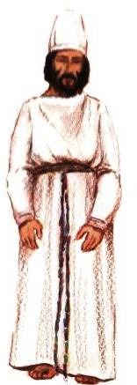

Slide 10
Qualifications for Priestly Service
Exodus 28:1
Numbers 4:3
Leviticus 21:16-23
Leviticus 21:9, 14
Ezekiel 44:22
Leviticus 22:3-9
Ezekiel 4:20
Leviticus 21:5
Exodus 28:1-4
Ezekiel 44:17-19
Leviticus 22:3-9
Ezekiel 4:20
Exodus 28:1-4
Ezekiel 44:17-18

Slide 11
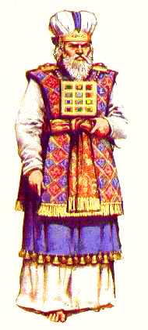

Slide 12
The High Priest
Hebrews 4:14

Slide 13
The Clothes of the High Priest
The Ephod
The Breastplate:
Exodus 28:17-20
Matthew 11:28
Matthew 20:28
John 10:15
1 Samuel 28:6
Acts 1:26
John 14:6

Slide 15
Service of Consecration
Exodus 29:4
Psalms 132:9, 10
Luke 12:26, 15, 19,20
Genesis 30:20
Judges 1:6
Numbers 4:3
Numbers 8:23-27

Slide 16
Numbers 8:18-24
Numbers 18:21
Hebrews 4:14-16
Hebrews 5:1-3
Hebrews 5:5-10
Hebrews 7:1-3,4
Hebrews 7:11,12,13,14,15
Hebrews 7:21, 25

Slide 17
Conclusion
Hebrews 8:1
Ephesians 4:11
1 Peter 2:5
Romans 12:1,6,7
1 Corintians 4:1-2
1 Timothy 3:1-13

Slide 18
Romans 12:3-8
Romans 9:21
2 Corinthians 13:10
1 Corinthians 3:16-17
Matthew 5:13-16

Slide 19
Finally
1 Peter 2:5
The Good News Translation:
“Come as living stones, and let yourselves be used in building the spiritual temple, where you will serve as holy priests to offer spiritual and acceptable sacrifices to God through Jesus Christ.”

