Slide 1
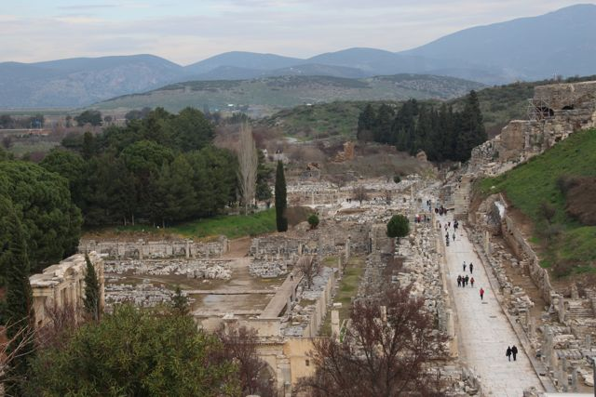
The Epistle to the Ephesians
1

Slide 2
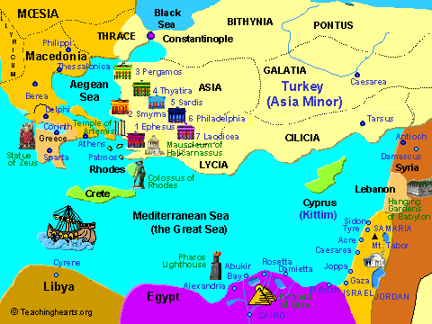
2
Ephesus in Turkey
Corinth in Greece

Slide 3
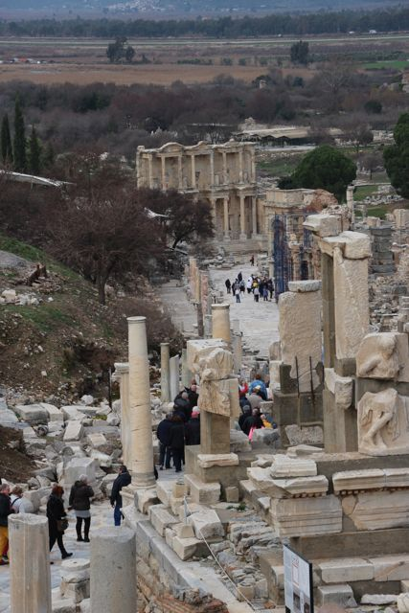
3
Ephesus

Slide 4
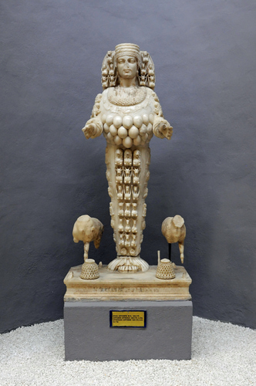
Diana of the Ephesians
Artemus
4

Slide 5
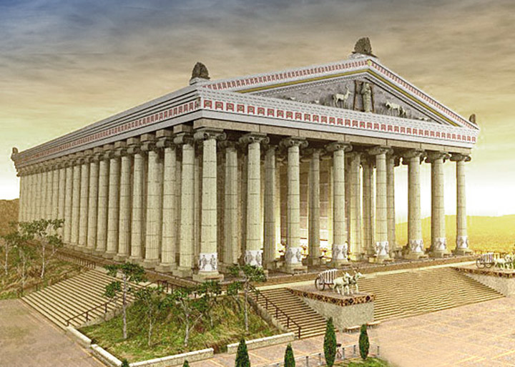
Temple of Artemus- Diana of the Ephesians
5

Slide 6
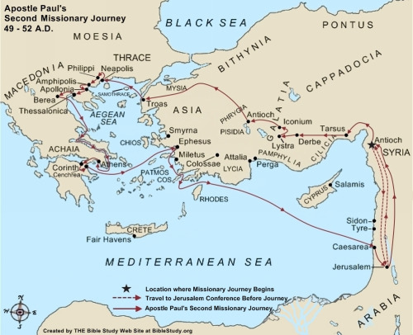
Apostle Paul’s Second Missionary Journey
6

Slide 7
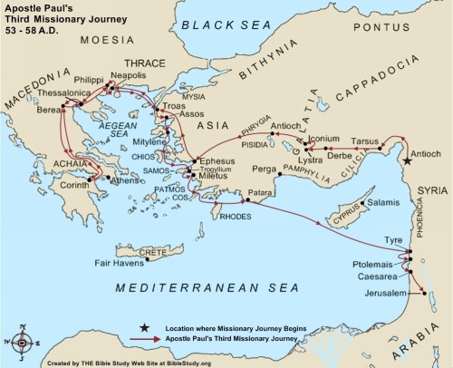
Apostle Paul’s Third missionary journey
7

Slide 8
Acts 16
Acts 18:18-21
Acts 18:24-26
Acts 19
8

Slide 9
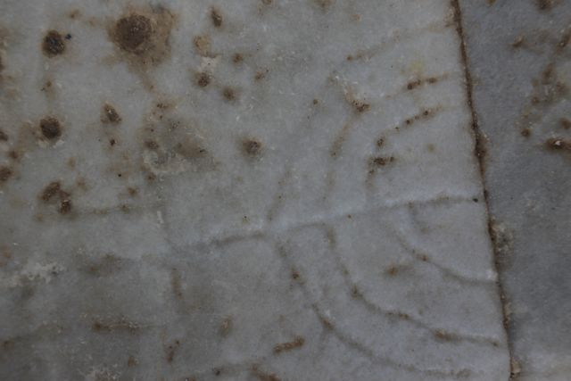
Menorah in marble steps to Library
9

Slide 10
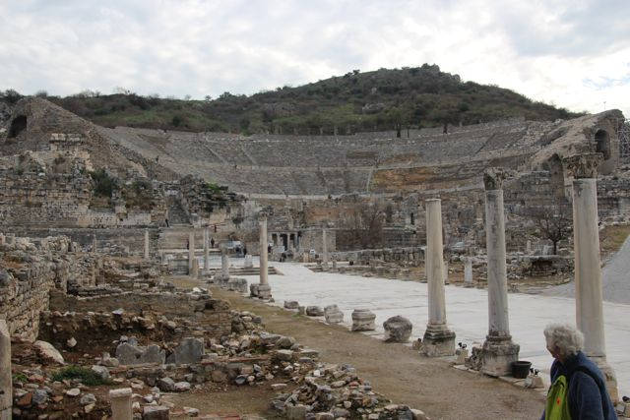
The Theatre
11

Slide 11
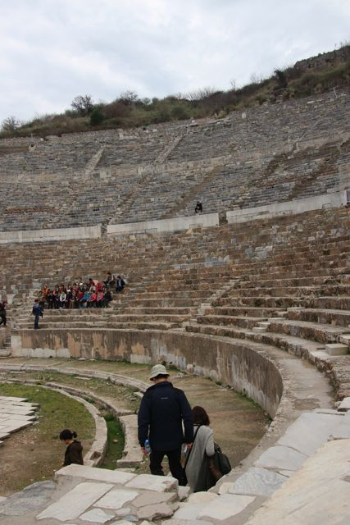
The Theatre at Ephesus
10
Acts 19:31
Acts 19:35-41
Acts 20:16-38
John 19:25-27

Slide 12
Revelation 2-3
Revelation 2:1-8
12

Slide 13
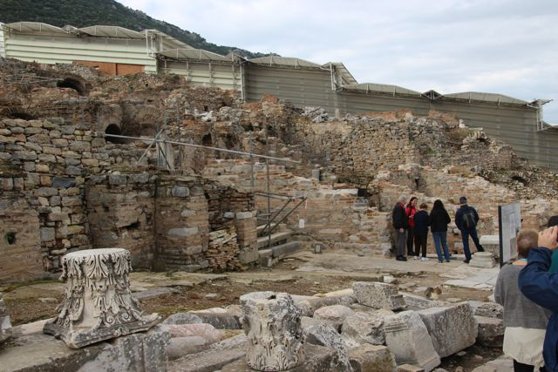
Ancient City of Ephesus
13

Slide 14
Epistle to the Ephesians
14
Ephesians 1:3-10, 16-19
Ephesians 2:4-10, 11-13, 19-22
Ephesians 3:1-7, 16-19
Ephesians 4:1-3, 12, 17-end, 32
Ephesians 5:1-2, 3-6, 15-19, 25

Slide 15
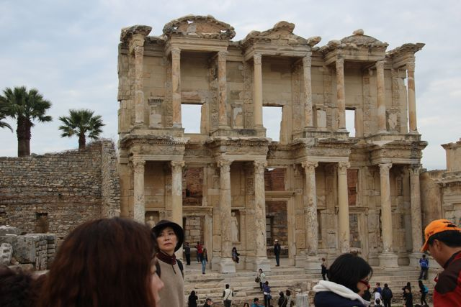
Celcius Library in Ephesus
15

Slide 16
Ephesians 6:1-4, 5-9, 10-20
Ephesians 6:21-24
16

Slide 17
We too – just like the Ephesians- are surrounded by a secular, pagan and corrupt society that we must resist not in our own strength but through the power of the Holy Spirit.
17

Slide 18
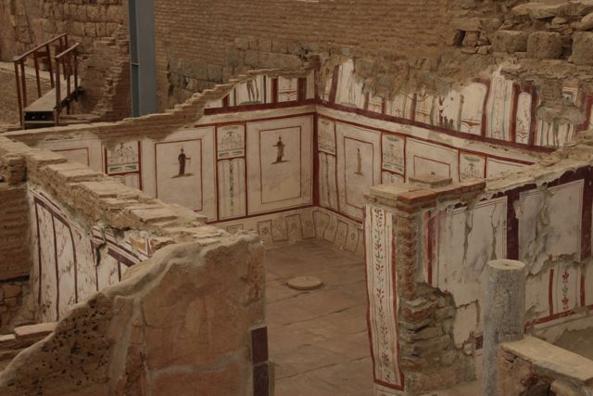
18
Remains of wealthy houses in Ephesus

Slide 19
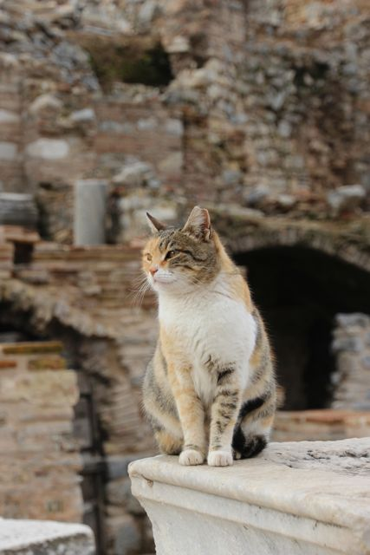
The only current residents of Ephesus
19

